Slide 1

London property Analysis
Week 2-M.Faizan Tahir

Slide 2

Business Problem
London housing market is in a nutshell
Brexit
Hidden Price falls
Record-Low Sales
Homebuilder exodus
Tax Hikes

Slide 3

Business Problem
How could we provide support to homebuyers clientele in to purchase a suitable real estate in London in this uncertain economic and financial scenario?

Slide 4
Solution
Clustering London neighborhoods in order to recommend venues and the current average price of real estate where homebuyers can make a real estate investment.

Slide 5
Data and Mehodolgy
Data: merging data on London properties and the relative price paid data from the HM Land Registry and data on amenities and essential facilities surrounding such properties from FourSquare API interface.
Mehodology:
Collect Inspection Data;
Explore and Understand Data;
Data preparation and preprocessing;
Modeling

Slide 6
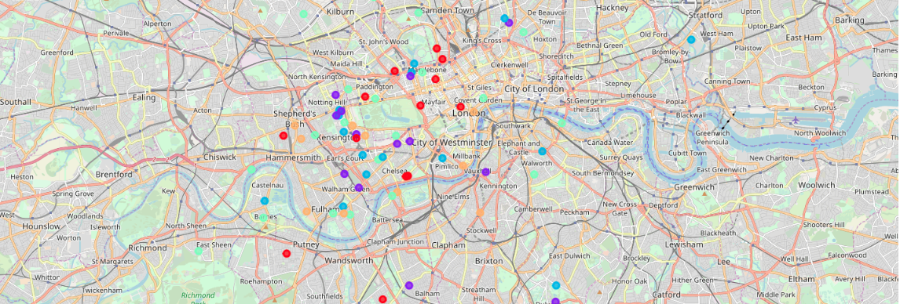
K-Mean Clustering

Slide 7
Outcome
Examination of real estates according to neighborhoods/London areas
West London (Notting Hill, Kensington, Chelsea, Marylebone) and North-West London (Hampsted) might be considered highly profitable venues to purchase a real estate
South-West London (Wandsworth, Balham) and North-West London (Isliington) are arising as next future elite venues with a wide range of amenities and facilities.

Slide 8
Outcome
Examination of real estates by clusters
Clusters 0, 2 and 4 may target home buyers prone to live in 'green' areas with parks, waterfronts
Clusters 1 and 3 may target individuals who love pubs, theatres and soccer.
.

Slide 9
Thank you

